Slide 1
Chapter 15
The Sports Analytics case study

Slide 2
Objectives
Applied
Given the code in any cell or group of cells in the Sports Analytics case study, describe what it does.
Knowledge
Describe the process for getting the Curry data from the JSON file into a DataFrame.
Compare the use of a density plot and a scatter plot for plotting shot location data.

Slide 3
Import the modules for this case study
import pandas as pd
import seaborn as sns
import json
from urllib import request

Slide 4
Get the Stephen Curry data
Step 1: Download the JSON file for the Curry shots data
shots_url = \
'https://www.murach.com/python_analysis/shots.json'
shots = request.urlretrieve(shots_url, filename='shots.json')
Step 2: Load the Curry shots data into a dictionary
with open('shots.json') as jsonData:
shots = json.load(jsonData)
shots.keys()
===================================================
dict_keys(['resource', 'parameters', 'resultSets'])

Slide 5
Build the DataFrame for the Curry data
Step 1: Get the column headers
columnHeaders = shots['resultSets'][0]['headers']
columnHeaders = [x.lower() for x in columnHeaders]
columnHeaders
==================================================
['grid_type',
'game_id',
'game_event_id',
'player_id',
...
'vtm']
Step 2: Get the rows data
rows = shots['resultSets'][0]['rowSet']

Slide 6
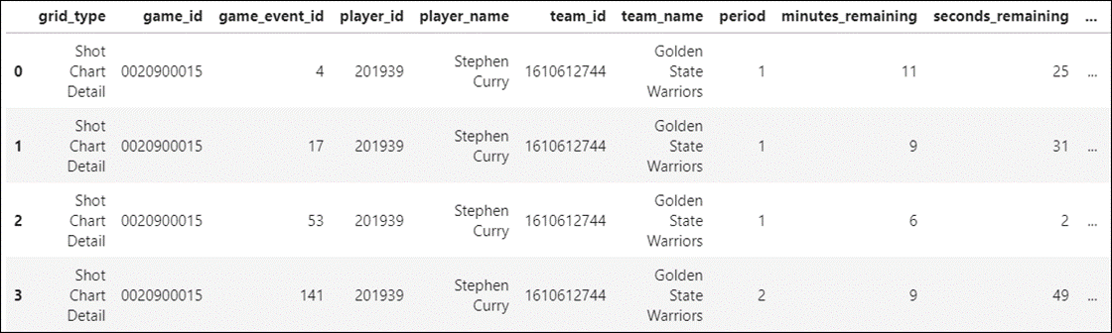
Build the DataFrame for the Curry data (cont.)
Step 3: Build the dataframe
shots = pd.DataFrame(data=rows, columns=columnHeaders)
shots.head(4)

Slide 7
View the data for the periods column
shots.period.unique()
===============================
array([1., 2., 4., 3., 5., 6.])
Drop the rows for periods 5 and 6
shots = shots.query('period < 5.0')

Slide 8
Locate unneeded columns
shots.nunique(dropna=False)
==========================
grid_type 1
game_id 692
game_event_id 692
player_id 1
player_name 1
team_id 1
team_name 1
period 4
minutes_remaining 12
...
shot_distance 71
loc_x 489
loc_y 437
shot_attempted_flag 1
shot_made_flag 2
game_date 692
htm 32
vtm 32

Slide 9
Locate unneeded columns (continued)
Drop the unneeded columns
shots = shots.drop(columns=['grid_type','game_event_id','team_id',
'team_name','player_id','shot_zone_range','shot_zone_basic',
'shot_zone_area','event_type','action_type','minutes_remaining',
'seconds_remaining','shot_distance','player_name','period','htm',
'vtm','shot_attempted_flag'])

Slide 10
Convert the game_date column to datetime data
shots.game_date = pd.to_datetime(shots.game_date)

Slide 11
Get the info for the columns that remain
shots.info()
===================================================
Int64Index: 11753 entries, 0 to 11845
# Column Non-Null Count Dtype
--- ------ -------------- -----
0 game_id 11753 non-null object
1 shot_type 11753 non-null object
2 loc_x 11753 non-null int64
3 loc_y 11753 non-null int64
4 shot_made_flag 11753 non-null int64
5 game_date 11753 non-null datetime64[ns]

Slide 12
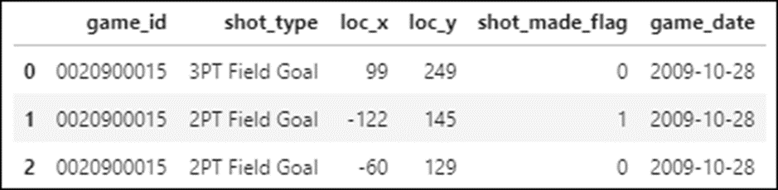
The shots DataFrame
shots.head(3)

Slide 13
Set an index on the game_id
shots.set_index('game_id', inplace=True)

Slide 14
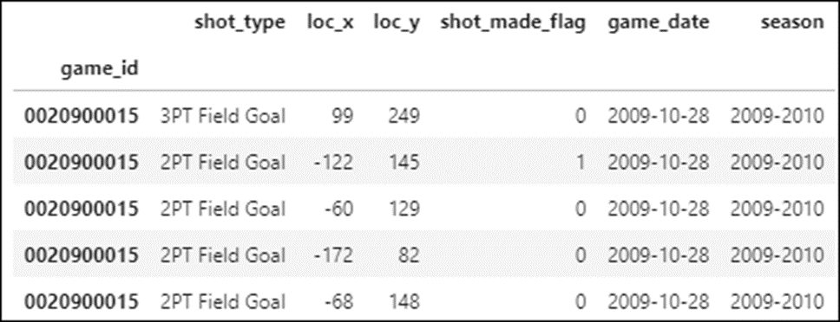
Add a column for the season
def get_season(row):
if row.game_date.month > 6:
season = f'{row.game_date.year}-{row.game_date.year + 1}'
else:
season = f'{row.game_date.year - 1}-{row.game_date.year}'
return season
shots['season'] = shots.apply(get_season, axis=1)
shots.head()

Slide 15
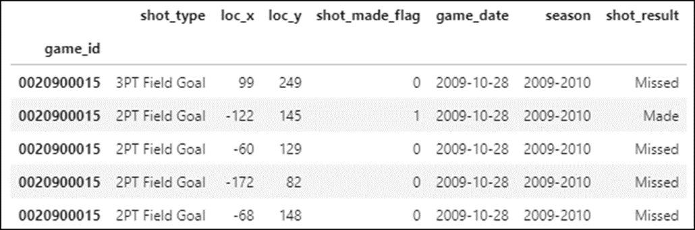
Add a string column for the shot result
shots['shot_result'] = \
shots.shot_made_flag.replace({0:'Missed', 1:'Made'})
shots.head()

Slide 16
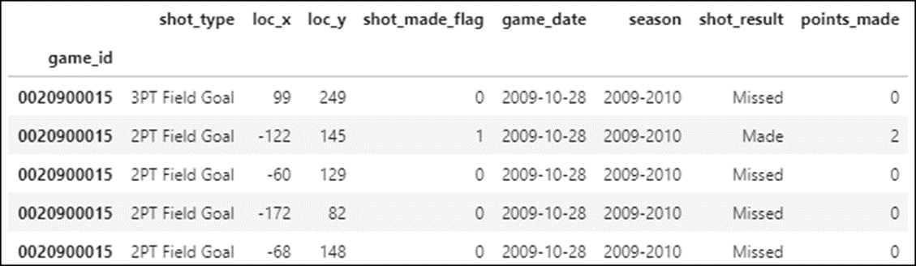
Add a column for points made for each shot
Check the shot types
shots['shot_type'].unique()
===========================
array(['3PT Field Goal', '2PT Field Goal'], dtype=object)
Add the points_made column
shots['points_made'] = \
shots.apply(lambda x: 0 if x.shot_result == 'Missed' else
(3 if x.shot_type == '3PT Field Goal' else 2), axis=1)
shots.head()

Slide 17
Add summary columns for points, shots attempted, and shots made
shots['points_made_game'] = \
shots.groupby('game_id').points_made.transform('sum')
shots['shots_attempted'] = \
shots.groupby('game_id').shot_made_flag.transform('count')
shots['shots_made'] = \
shots.groupby('game_id').shot_made_flag.transform('sum')
shots[['shot_type','points_made','points_made_game',
'shots_attempted','shots_made']]

Slide 18
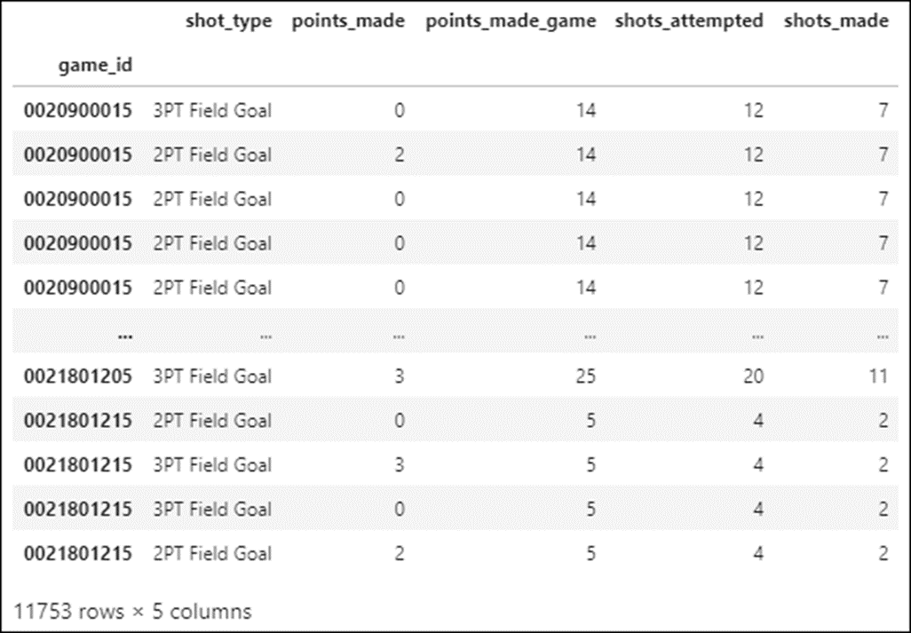
Add summary columns (continued)

Slide 19
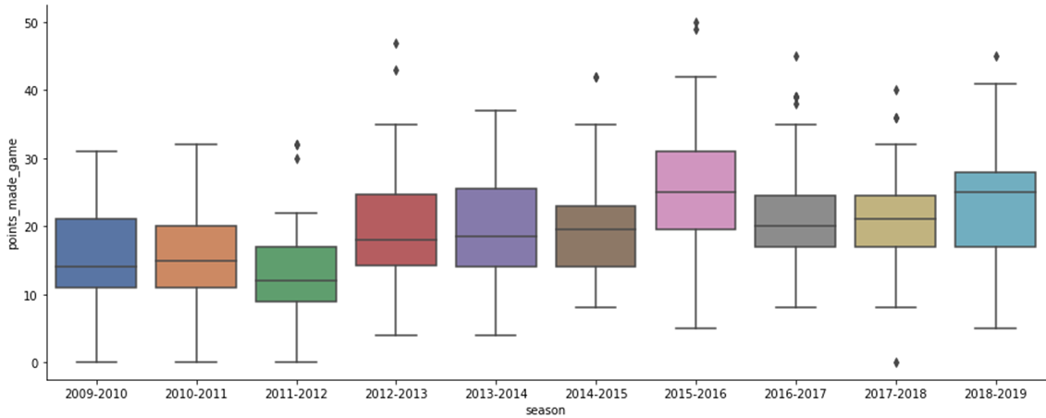
Plot the points per game by season
Get the data for the seasons
shotsSeason = \
shots[['season','game_date','points_made_game',
'shots_made','shots_attempted']].drop_duplicates()
Plot the points per game by season
sns.catplot(data=shotsSeason, kind='box', x='season',
y='points_made_game', aspect=2.5, palette='deep')

Slide 20
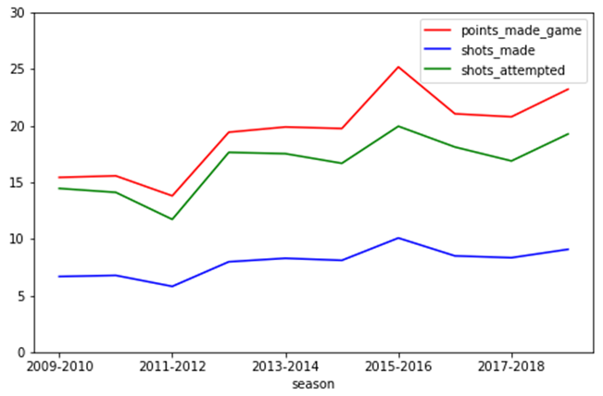
Plot the averages of shots, shots made, and points per game by season
Group the data
shotsSeasonAvg = shotsSeason.groupby('season').mean().reset_index()
Plot the data with the Pandas plot() method
shotsSeasonAvg.plot(x='season',
y=['points_made_game','shots_made','shots_attempted'],
color={'points_made_game':'red','shots_made':'blue',
'shots_attempted':'green'}, figsize=(8,5), ylim=(0,30))

Slide 21
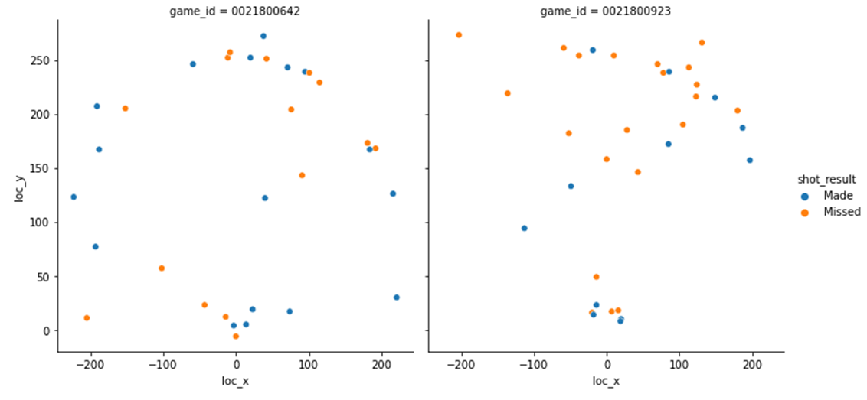
Plot the shot locations for two games
gameIDs = ['0021800923','0021800642']
g = sns.relplot(data=shots.query('game_id in @gameIDs'),
kind='scatter', x='loc_x', y='loc_y',
hue='shot_result', col='game_id')

Slide 22
Plot the shots and draw the court with the draw_court() method
g = sns.relplot(data=shots.query('game_id in @gameIDs'),
kind='scatter', x='loc_x', y='loc_y',
hue='shot_made_flag', col='game_id', s=50)
for i, ax in enumerate(g.axes.flat):
ax = draw_court(ax, outer_lines=True)
ax.set_xlim(-300, 300)
ax.set_ylim(-100, 500)

Slide 23
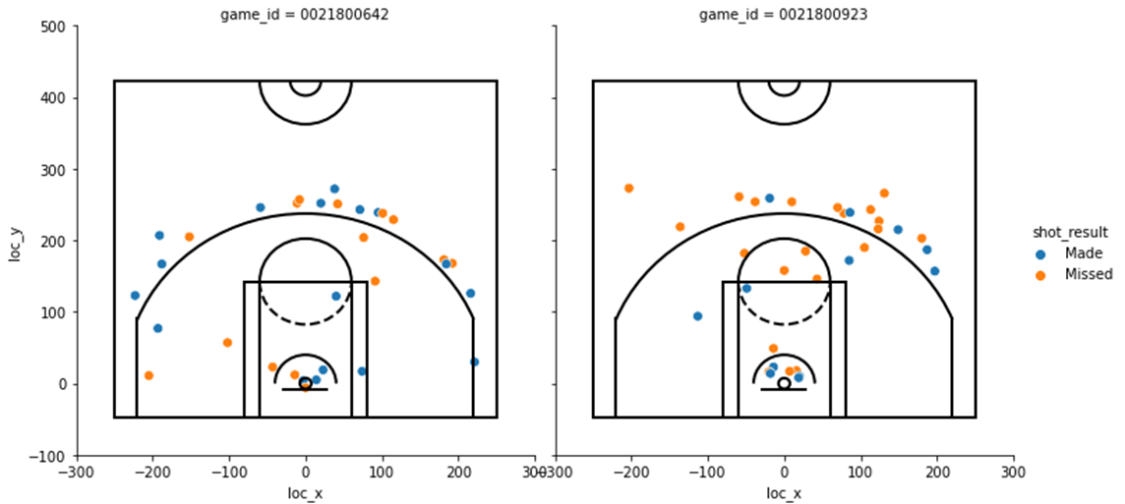
Plot the shots and draw the court (continued)

Slide 24
Plot the shot locations for two seasons
colors = ['#FF0B04','#4374B3'] # blue and red
sns.set_palette(sns.color_palette(colors))
seasons = ['2009-2010','2015-2016']
g = sns.relplot(data=shots.query('season in @seasons'),
kind='scatter', x='loc_x', y='loc_y',
hue='shot_result', col='season')
for ax in g.axes.flat:
ax = draw_court(ax, outer_lines=True)
ax.set_xlim(-300, 300)
ax.set_ylim(-100, 500)

Slide 25
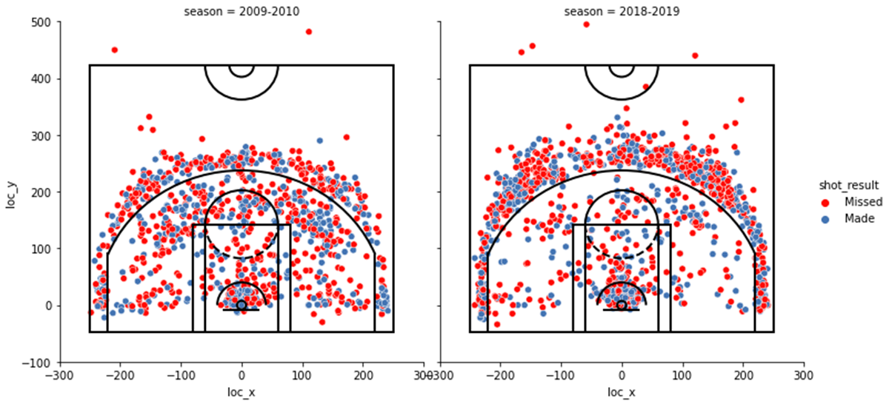
Plot the shot locations for two seasons (cont.)

Slide 26
Plot the shot density for one season
colors = ['#4374B3','#FF0B04'] # red and blue
sns.set_palette(sns.color_palette(colors))
g = sns.displot(data=shots.query('season == "2015-2016"'),
kind='kde', legend=False, x='loc_x',
y='loc_y', col='shot_result',
hue='shot_result')
for ax in g.axes.flat:
ax = draw_court(ax, outer_lines=True)
ax.set_xlim(-300, 300)
ax.set_ylim(-100, 500)

Slide 27
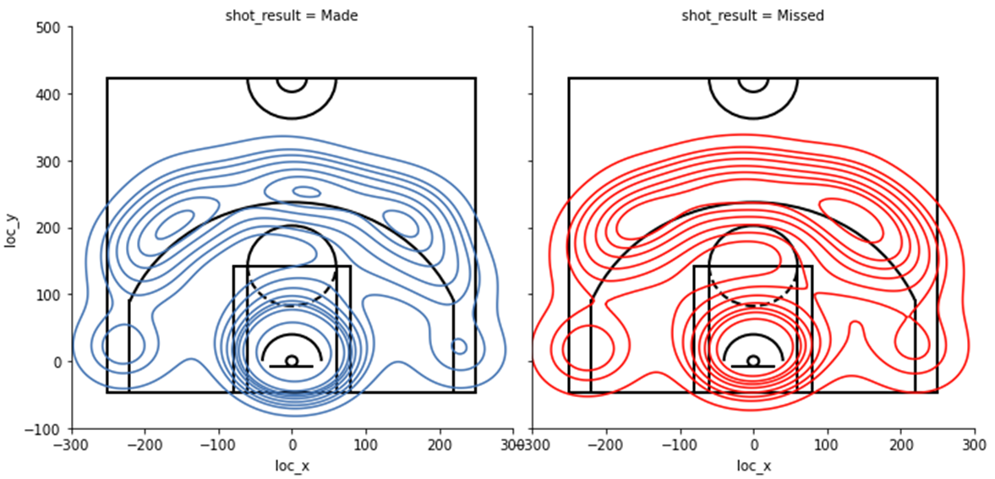
Plot the shot density for one season (cont.)

Slide 28
Plot the shot density for two seasons
colors colors = ['#FF0B04','#4374B3'] # blue and red
sns.set_palette(sns.color_palette(colors))
seasons = ['2009-2010','2015-2016']
g = sns.displot(data=shots.query('season in @seasons'),
kind='kde', x='loc_x', y='loc_y',
row='shot_result', col='season',
hue='shot_result', legend=False)
for ax in g.axes.flat:
ax = draw_court(ax, outer_lines=True)
ax.set_xlim(-300, 300)
ax.set_ylim(-100, 500)

Slide 29
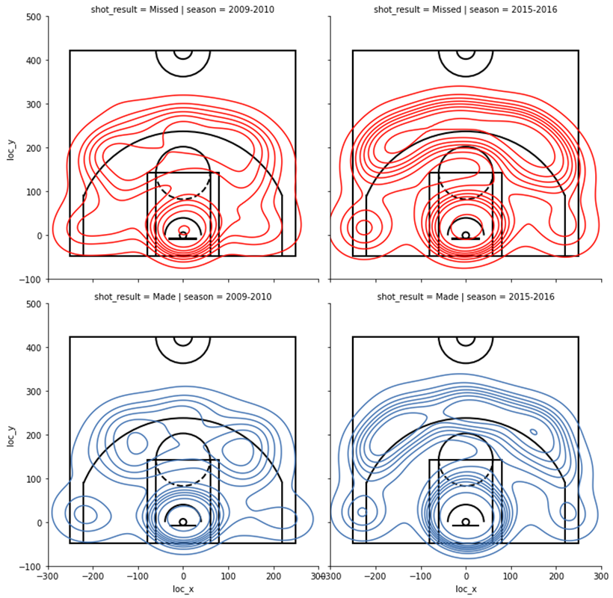
Plot the shot density for two seasons (cont.)

